Slide 1
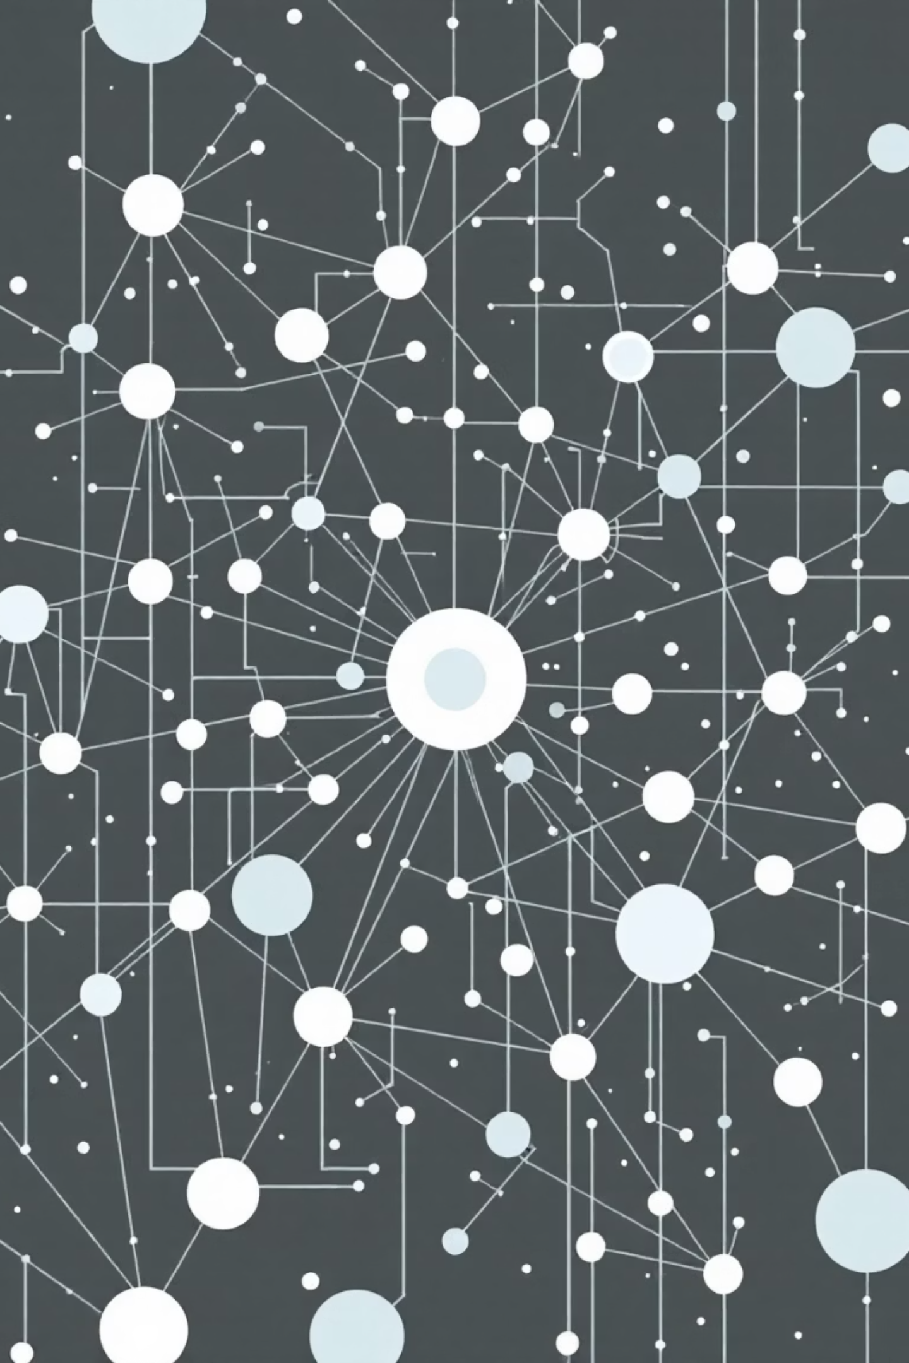
Knowledge Graph-based Fake News Detection and Analysis System
By Group 3
Isha Sudarshini
Aswini P
Kungumapriya
Varshitha B U

Slide 2
Knowledge Graphs
A Knowledge Graph (KG) is a structured representation of knowledge that captures entities and their relationships. In the context of Natural Language Processing (NLP), KGs provide a contextual understanding of information extracted from text, moving beyond simple keyword matching to nuanced semantic comprehension.
Addressing Information Overload
Enhancing Semantic Understanding
Core Application
KGs transform freeform text into useful, meaningful, and organized information, serving as a compelling tool for solving complex real-world problems.
The exponential growth of heterogeneous, unstructured data necessitates efficient methods for integration and analysis.
Unlike traditional statistical methods, KGs utilize semantics to allow for more accurate data extraction and sophisticated reasoning.

Slide 3







Project Objectives & Scope
Detect Fake and True News
Perform Named Entity Recognition and Relation Extraction
Build and Visualize a Knowledge Graph
Develop a machine learning-based classifier for accurate news credibility assessment.
Create a structured visual representation of extracted entities and their interconnections.
Automatically identify key entities and their relationships within news articles.
Perform Community Detection and Centrality Analysis
Enable Question Answering
Implement Cross-Domain Linking
Facilitate quick information retrieval through intuitive question-answering capabilities over the extracted knowledge.
Identify and connect related entities across diverse topics and datasets.
Understand information clusters and influential entities within the news landscape.
Deploy as an Interactive Web Application
Launch the system as a user-friendly Streamlit application for broad accessibility.
Scope
The system focuses on processing news articles and providing both analytical and interactive components for end-users. It is designed for scalability and can be adapted for other text-based datasets, such as research papers, blogs, or social media posts. The inclusion of a fake news classifier ensures the system can serve as both an information exploration tool and a credibility assessment platform.

Slide 4
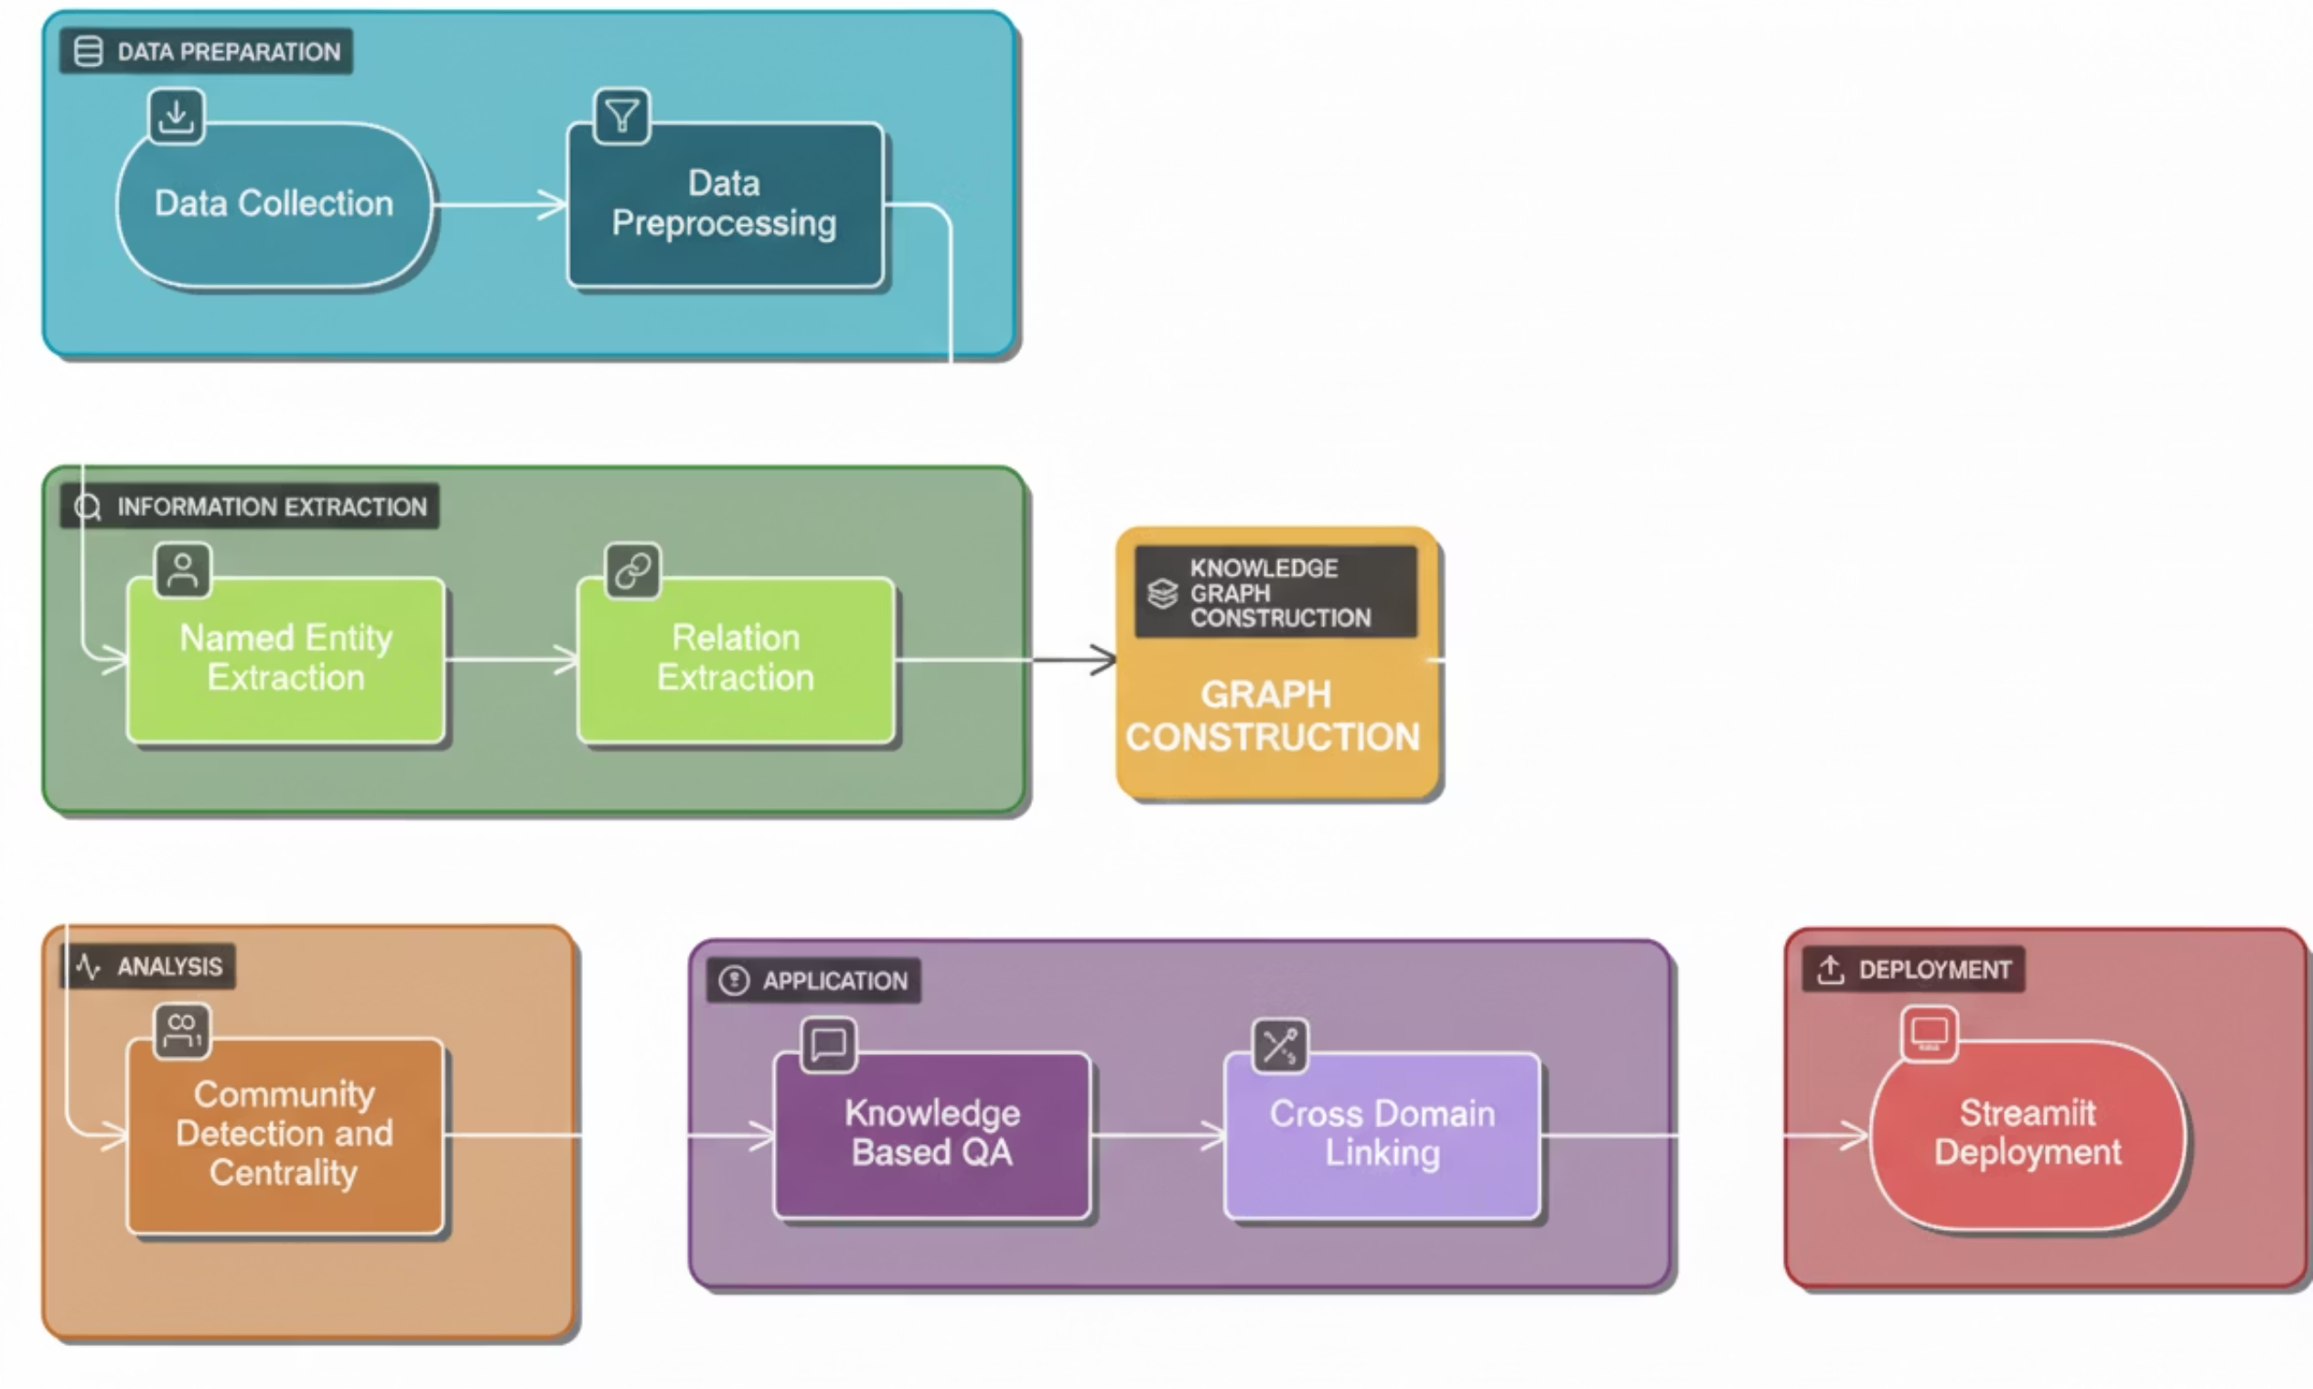
Project Workflow
We outline a complete end-to-end workflow, transforming raw text data into a queryable knowledge graph and deploying a practical application.

Slide 5

Step 1: Data Acquisition and Preparation
Gathering Relevant Textual Data
The foundational step involves gathering relevant textual data from diverse sources such as articles, documents, and websites. The quality and diversity of this initial dataset directly impact the richness of the resulting knowledge graph.
Source Diversity
Data can include books, articles, domain-specific documents, or proprietary text.
Focus: Fake News Detection
Our project utilizes the ISOT Fake News Dataset from Kaggle, containing over 25,000 articles.
The dataset includes two types of articles: "True.csv" (12,600+ articles from reputable sources like reuter.com) and "Fake.csv" (12,600+ articles from unreliable sources flagged by Politifact and Wikipedia).
Each article provides: Title, Text, Type (Real/Fake), and Date.

Slide 6







Step 2: Data Preprocessing
Missing Values
Duplicate Entries
Text Cleaning & Normalization
Rows containing missing text or labels were identified and removed from the dataset.
Identified and removed using Pandas' duplicated() function to ensure data uniqueness.
This involved lowercasing all text, removing URLs and HTML tags, eliminating punctuation, and normalizing whitespace.
Tokenization & Stopword Removal
Label Encoding & Data Balancing
TF-IDF Vectorization
Text was tokenized into individual words, and common stopwords were removed to reduce noise.
Categorical labels were encoded, and techniques were applied to balance the dataset, preventing bias towards dominant classes.
Textual data was transformed into numerical features using Term Frequency-Inverse Document Frequency (TF-IDF).
Data Split
The preprocessed dataset was split into 80% for training and 20% for testing to evaluate model performance.

Slide 7





Step 3: Named Entity Recognition (NER)
Named Entity Recognition (NER) is a crucial step in natural language processing (NLP) that involves identifying and classifying key information (entities) in text into predefined categories such as person names, organizations, locations, dates, and more.
Primary Objectives
Extract Key Entities: Identify names of people, organizations, locations, and other relevant entities mentioned in news articles
Feature Enhancement: Enrich the dataset with entity-based features to improve machine learning model performance
Pattern Analysis: Analyze entity distribution between fake and real news to detect unusual trends or anomalies
Tools and Libraries
Language Model: en_core_web_sm was employed as the pre-trained model for entity recognition
NER Pipeline: spaCy's built-in pipeline automatically identifies and labels entities in the text

Slide 8



Step 4: Relation Extraction
Relation Extraction follows Named Entity Recognition (NER) and determines how these entities are related within a sentence or across sentences. These relationships are crucial for constructing meaningful connections in the knowledge graph.
Key Components
SVO Relationships
Triple Formation
Storage System
The system implemented relation extraction to identify Subject-Verb-Object (SVO) relationships in the news text.
Converting natural language relationships into structured triples (Subject, Predicate, Object).
Extracted triples were systematically stored in a JSON-based database for easy access.

Slide 9
Step 5: Knowledge Graph Construction
A Knowledge Graph (KG) represents entities as nodes and relationships as edges, capturing both syntactic and semantic connections between them. Knowledge graphs help in visualizing information networks, identifying hidden patterns, and enabling knowledge-based reasoning.
Key Components
Technical Implementation
Library
Nodes
NetworkX for robust graph construction and manipulation.
Directly represent extracted entities derived from Named Entity Recognition (NER).
Edges
Labels
Formed by relationships identified through relation extraction processes.
Crucial for capturing precise relationship types and semantic connections between entities.

Slide 10



Graph Analysis: Centrality Measures
In complex networks like knowledge graphs, Centrality and Community Detection uncover hidden structures and identify key influencers, providing deeper insights into knowledge organization.
Centrality: Quantifying Influence
Centrality refers to measures that determine the importance or influence of a node. It answers: "Which entity plays a central role in connecting different pieces of information?"
Degree Centrality
Betweenness Centrality
Closeness Centrality
Measures the number of direct connections. High degree suggests the entity is a major topic or concept that interacts frequently.
Measures how often a node lies on the shortest path between others. High betweenness entities act as critical bridges or connectors.
Indicates how quickly an entity can reach all other nodes. High closeness suggests rapid influence or access to information across the network.
In this project, centrality highlights the most influential entities (key people, events, or sources) in the news graph.

Slide 11
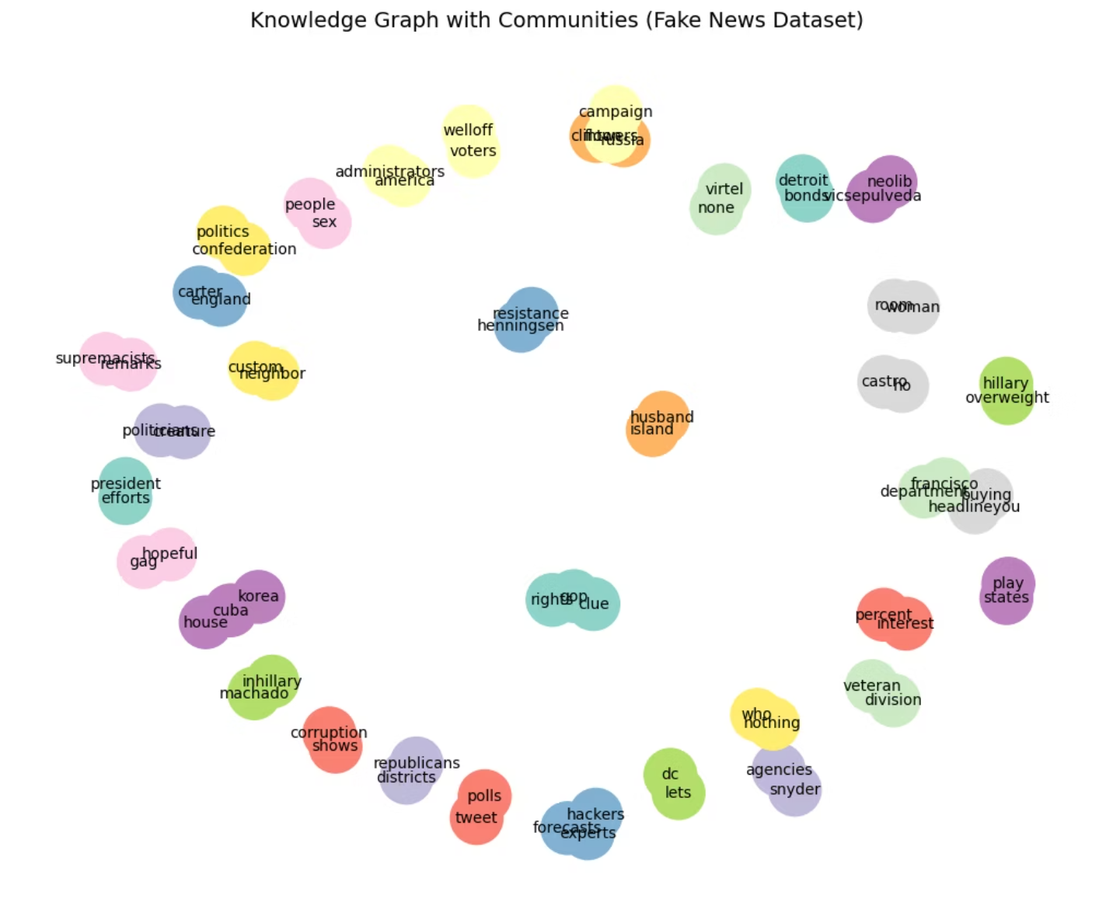
Graph Analysis: Community Detection
Community detection identifies subgroups of nodes that are more densely connected to each other than to the rest of the network, effectively revealing topical clusters.
Identifying Topic Clusters
Nodes within a community share strong, consistent relationships or frequently appear together in the same context.
Communities help reveal topic clusters, such as groups of entities involved in a specific event or domain.
We used the Louvain Algorithm, which detects communities by maximizing modularity (dense internal links, sparse external links).
Automatically assigns each node to a community ID.
Implemented using the community_louvain library.
Community detection helps to group related news topics—e.g., separating "scientific discoveries" from "political events"—providing a clearer contextual map of the news landscape.

Slide 12
Knowledge-Driven Question Answering (QA)
The QA system enables users to query factual information directly from the constructed knowledge graph, leveraging the structured nature of the data.
User Query
Query Conversion
Natural language question is input by the user.
System processes the query and converts it into a structured graph pattern (Subject, Predicate, Object).
Graph Search
Result Output
System searches the KG edges (relations) to find matching S–P–O triples.
The matched triple or entity is returned as the direct answer.
Factual Representation
The QA system operates on the core unit of the KG: the subject–predicate–object (S–P–O) triple.
Example Triple: (Marie Curie, discovered, Radioactivity)
User Question: “Who discovered radioactivity?”
System Action: Searches for a triple matching (X, discovered, Radioactivity) and returns 'Marie Curie'.

Slide 13
Cross-Domain Linking
The process of connecting related entities and facts across diverse subject areas to create a holistic, contextualized knowledge graph.
What It Means
Strategic Importance
Connects entities and facts across different knowledge domains (e.g., Politics, Health, Technology) to build a comprehensive and contextual knowledge graph.
Exposes hidden relationships and misinformation flow, critical for fraud/fake news detection.
Enhances semantic understanding and reasoning capabilities for advanced QA systems.
Allows analysis to transcend single topics, providing a broader, linked context.
Implementation Workflow
Domain Classification
Entity Extraction
Tag each article based on its primary subject (Politics, Health, Tech, etc.).
Extract all relevant entities and relational triples using NLP tools like SpaCy.
Graph Integration
Multi-Modal Linking
Merge domain-specific sub-graphs into a unified, global knowledge graph.
Exact Match: Linking based on identical entity names.
Semantic Match: Linking entities with similar meaning using embeddings (e.g., SentenceTransformer).
External Linking: Aligning entities with external, established sources (Wikidata, DBpedia).

Slide 14
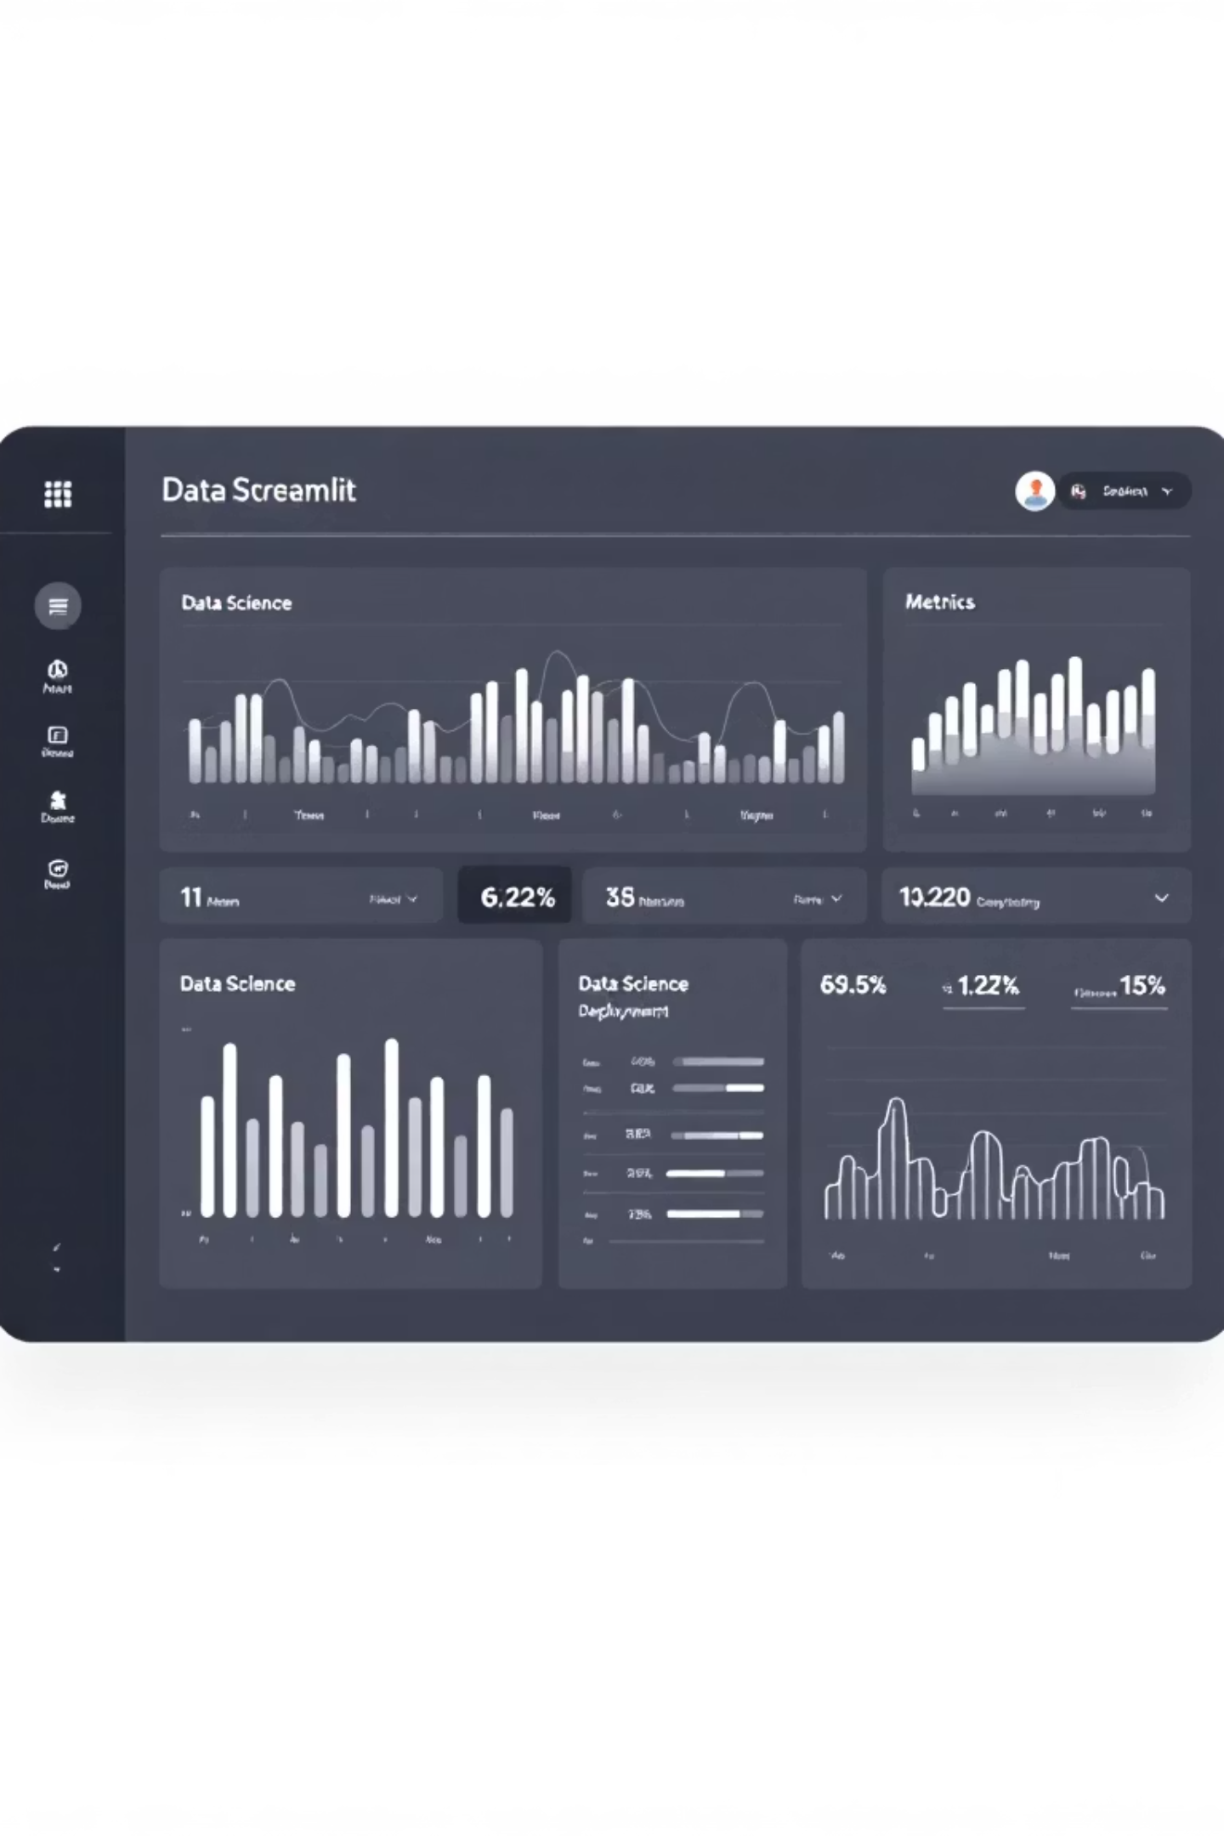

Deployment: Making the Knowledge Accessible
Streamlit Deployment
To make the knowledge graph and its capabilities (like QA and centrality analysis) available to end-users, the application is deployed using Streamlit.
Interactive Dashboard
Rapid Prototyping
Provides a simple, elegant web interface for querying the graph and visualizing results.
Streamlit allows for fast transformation of data scripts into shareable web apps without extensive front-end development.
Accessibility
Enables non-technical stakeholders and researchers to interact with the sophisticated NLP and graph analysis outputs.

Slide 15

Conclusion and Future Scope
Knowledge graphs offer a powerful framework for enhancing NLP by providing semantic context and structure to unstructured text. The presented workflow delivers a functional, queryable system for news analysis.
Key Takeaways
KGs enable sophisticated reasoning over text data.
Graph analysis techniques reveal hidden network structures.
The end-to-end system can be deployed efficiently using modern tools.
Future Directions
Integrate temporal dynamics into the graph for event tracking.
Apply Graph Neural Networks (GNNs) for link prediction and entity classification.
Expand the QA system to handle multi-hop reasoning and complex questions.
Adopting knowledge graph methodology is essential for NLP practitioners seeking to build robust, explainable, and context-aware applications.

Slide 16
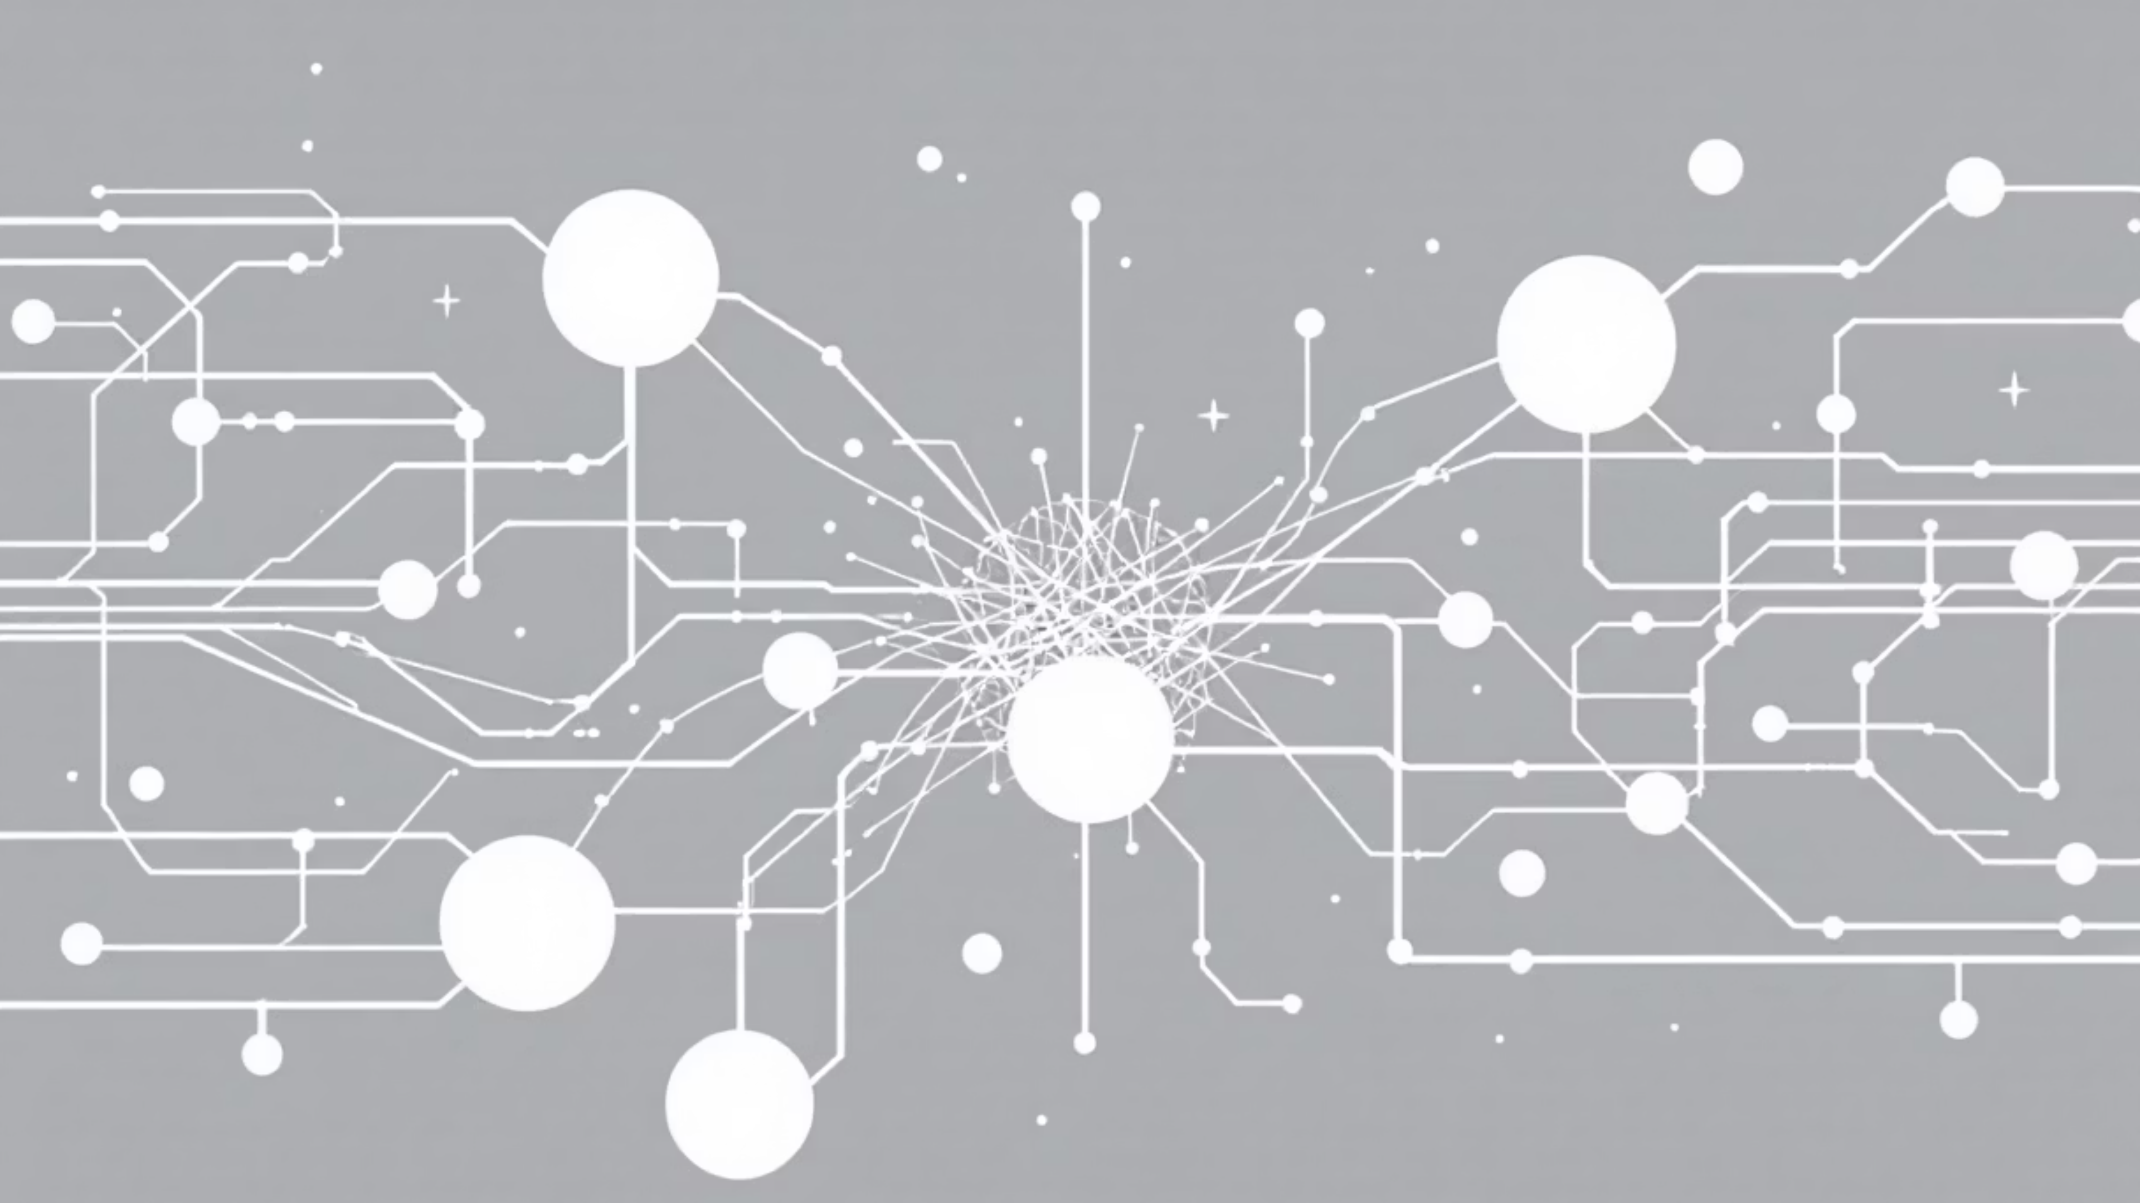
Thank You

